Slide 1
Visual Inspections of DWI Data
This is a powerpoint presentation that demonstrates validation of the visual inpsections done for DWIConvert refactoring's.

Slide 2
New meta-data added to NRRD files
DICOM_0008_0060_Modality:=MR DICOM_0008_0070_Manufacturer:=SIEMENS DICOM_0008_1090_ManufacturerModelName:=TrioTim DICOM_0018_0022_ScanOptions:=PFP\FS DICOM_0018_0023_MRAcquisitionType:=2D DICOM_0018_0080_RepetitionTime:=12000 DICOM_0018_0081_EchoTime:=92 DICOM_0018_0083_NumberOfAverages:=1 DICOM_0018_0087_MagneticFieldStrength:=3 DICOM_0018_1020_SoftwareVersions:=syngo MR B13 4VB13A DICOM_0018_1314_FlipAngle:=90

Slide 3
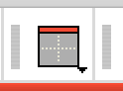
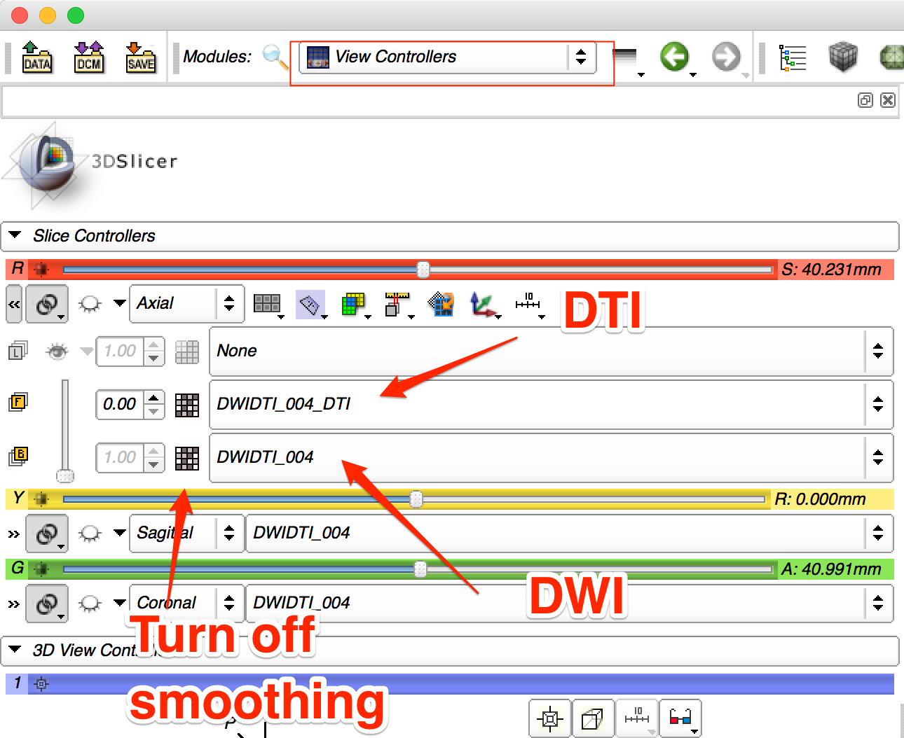
DWI Presentation Red slice only

Slide 4
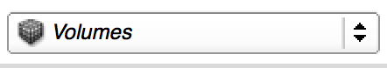
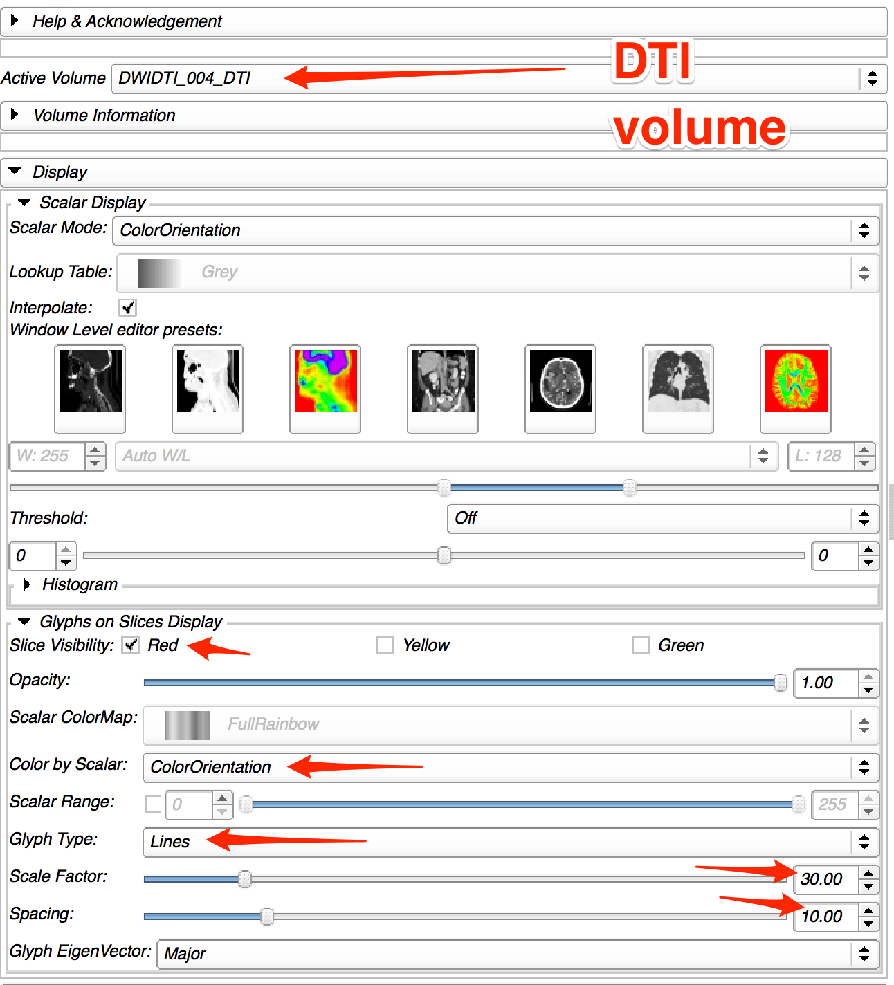
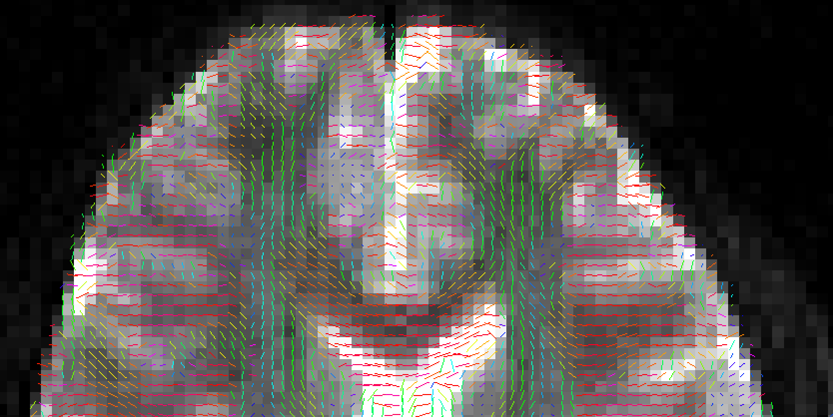
Slicer Visualization Notes (Volumes Module)

Slide 5
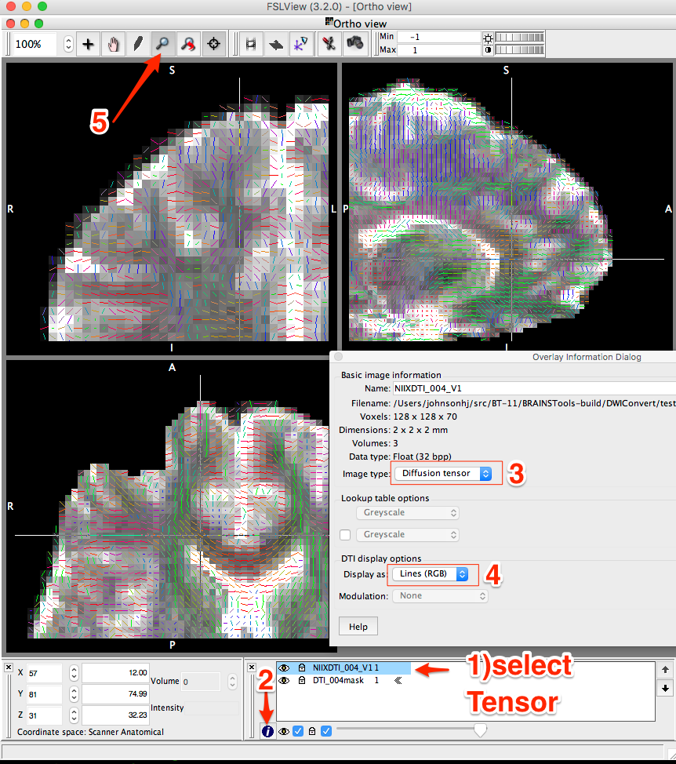
fslview
Need a mask image made by bet2 to view
fslview \ DTI_004/NIIX_dti/DTI_004mask.nii.gz \ DTI_004/NIIX_dti/NIIXDTI_004_V1.nii*

Slide 6
Generate visualization of tensor representation
This slide deck describes how to generate visualizations needed to give confidence that DWIConvert is doing the correct behavior.
FSL data prep
DTIProcessToolkit data prep

Slide 7
FSL Data Preparation
/opt/dcm2niix/bin/dcm2niix -m -b y -t y -v y -z i -o ${outdir} -f "${dicomDir}" ${dicomDir}
/Users/johnsonhj/src/BT-11/bin/DWIConvert \
--conversionMode FSLToNrrd \
--allowLossyConversion \
--useIdentityMeaseurementFrame \
--inputVolume ${outdir}/DWI${dicomDir}.nii \
--outputDirectory ${outdir} \
--outputVolume Recovered${dicomDir}.nhdr
bet2 ${outdir}/${dicomDir}.nii.gz ${outdir}/NIIX_dti/${dicomDir}mask.nii.gz
/opt/fsl/bin/dtifit \
--data=${outdir}/${dicomDir}.nii.gz \
--out=${outdir}/NIIX_dti/NIIX${dicomDir} \
--mask=${outdir}/NIIX_dti/${dicomDir}mask.nii.gz \
--bvecs=${outdir}/${dicomDir}.bvec \
--bvals=${outdir}/${dicomDir}.bval \
--wls --sse --save_tensor
${FSLVIEW} ${outdir}/NIIX_dti/${dicomDir}mask.nii.gz ${outdir}/NIIX_dti/NIIX${dicomDir}_V1.nii*

Slide 8
DTIProcessing Toolkit
/Users/johnsonhj/src/BT-11/bin/DWIConvert \
--conversionMode [ FSLToNrrd | DicomToNrrd] \
--allowLossyConversion \
--useIdentityMeaseurementFrame \
--inputVolume ${outdir}/${dicomDir}.nii.gz \
--outputDirectory ${outdir} \
--outputVolume NIIX${dicomDir}.nhdr
~/src/NEP-11/bin/dtiestim \
--inputDWIVolume ${outdir}/DWI${dicomDir}.nhdr \
--outputDTIVolume ${outdir}/DWI${dicomDir}_DTI.nhdr \
-t 0
/Applications/Slicer.app/Contents/MacOS/Slicer \
${outdir}/DWI${dicomDir}.nhdr \
${outdir}/DWI${dicomDir}_DTI.nhdr

Slide 9
Slicer Processing tools
${SLICER_EXTENSION_BIN}/DiffusionWeightedVolumeMasking \ --baselineBValueThreshold 100 --removeislands \ ${DWIIN} ${BASELINEOUT} ${DWIBRAINMASK}
${SLICER_EXTENSION_BIN}/DWIToDTIEstimation \ --enumeration LS \ --mask ${DWIBRAINMASK} \ ${DWIIN} ${DTIOUT} ${BASELINEOUTDTI}

Slide 10
Suspicious images marked with blue start
Images marked with a blue star are still not consiserd passed. Further invesitgations need to be made for those images.

Slide 11
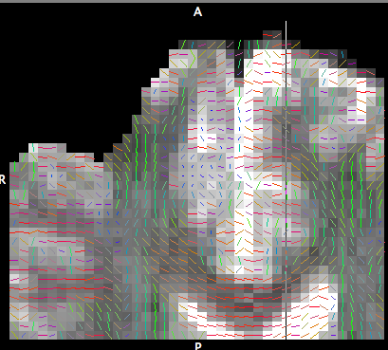
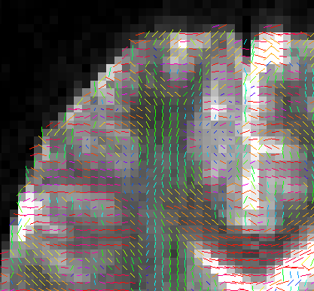
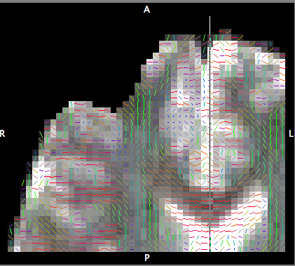
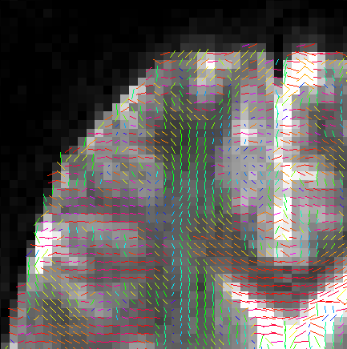
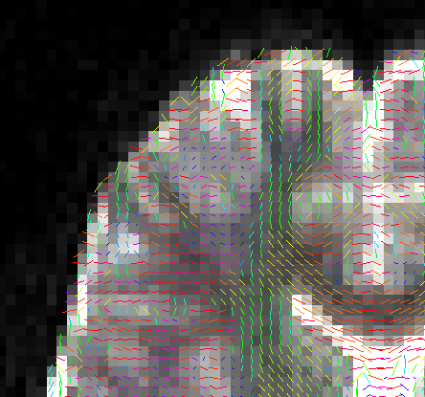
==== DTI_004
NIIXFSL
DicomToNrrd
DicomToFSL
NIIXFSLToNrrd
DicomToFSLToNrrd
FSLVIEW
Slicer Display

Slide 12
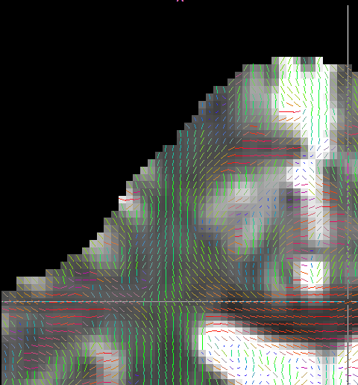
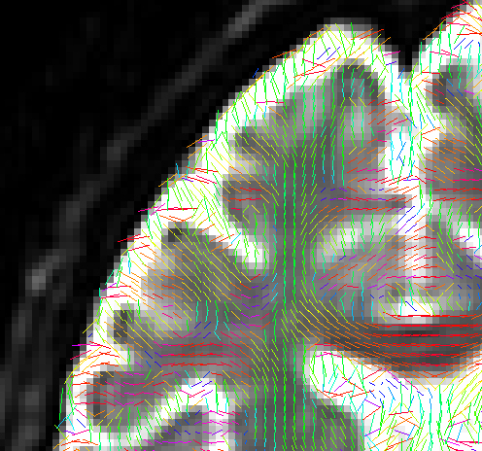
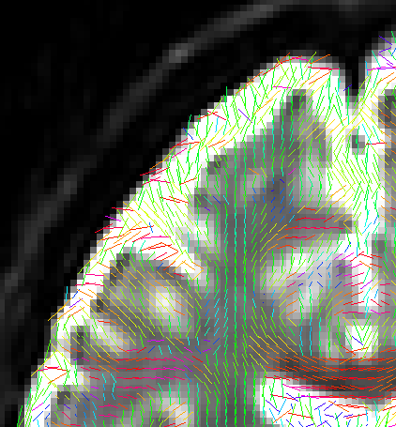
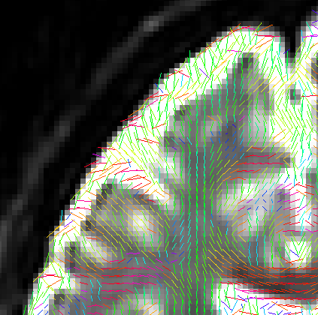
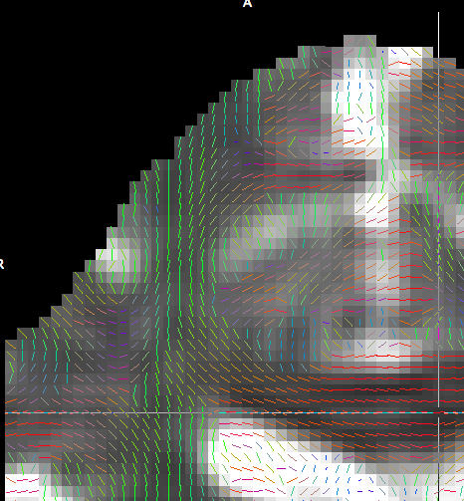
==== GeSignaHDx
NIIXFSL
DicomToNrrd
DicomToFSL
NIIXFSLToNrrd
DicomToFSLToNrrd
FSLVIEW
Slicer Display

Slide 13
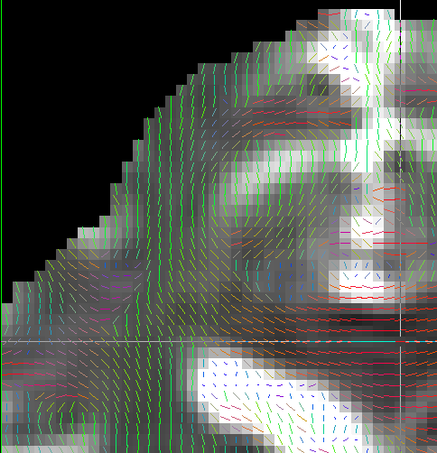
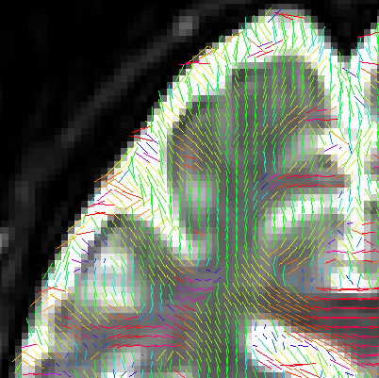
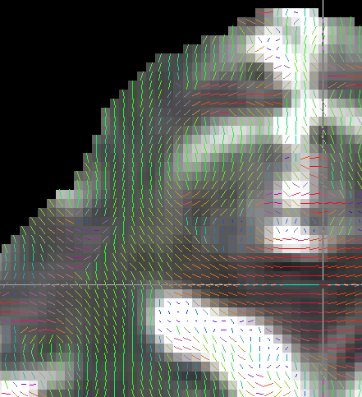
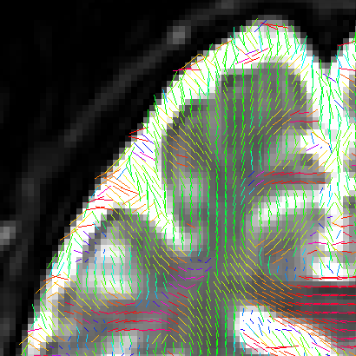
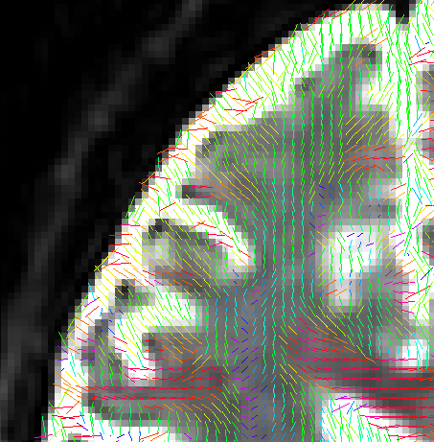
==== GeSignaHDxBigEndian
NIIXFSL
DicomToNrrd
DicomToFSL
NIIXFSLToNrrd
DicomToFSLToNrrd
FSLVIEW
Slicer Display

Slide 14
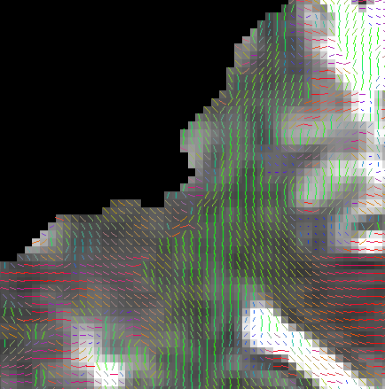
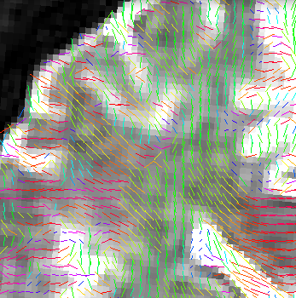
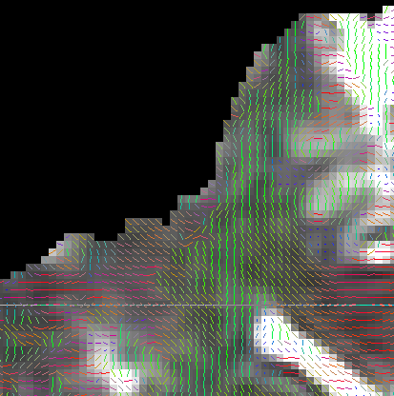
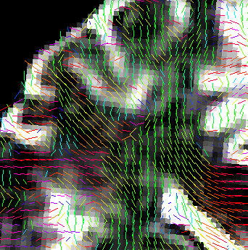
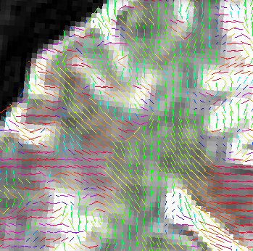
==== GeSignaHDxt
NIIXFSL
DicomToNrrd
DicomToFSL
NIIXFSLToNrrd
DicomToFSLToNrrd
FSLVIEW
Slicer Display

Slide 15
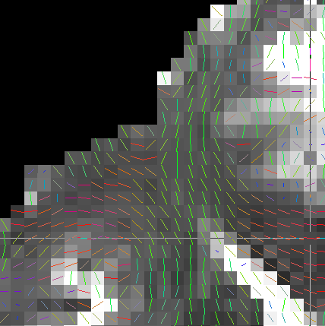
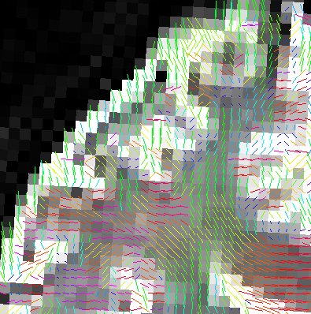
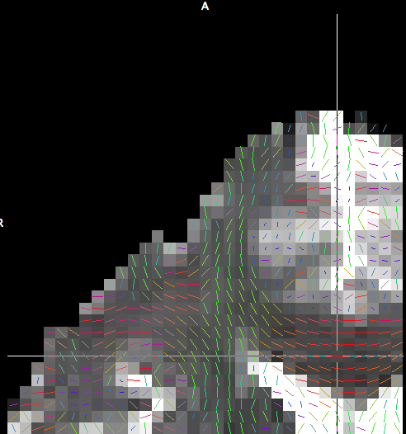
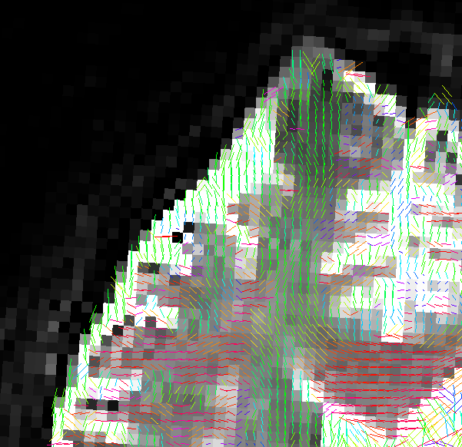
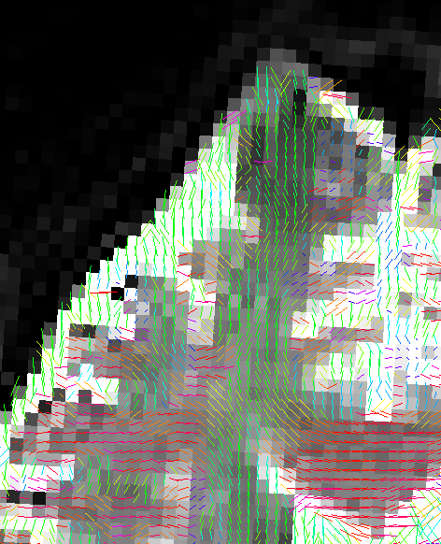
==== PhilipsAchieva1 (Floating point data, scaled)
NIIXFSL
DicomToNrrd
DicomToFSL
NIIXFSLToNrrd
DicomToFSLToNrrd
FSLVIEW
Slicer Display

Slide 16
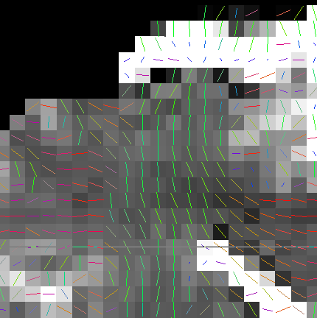
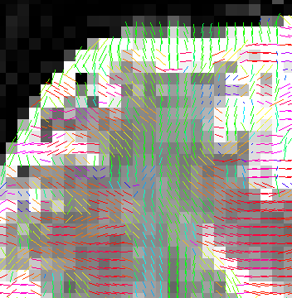
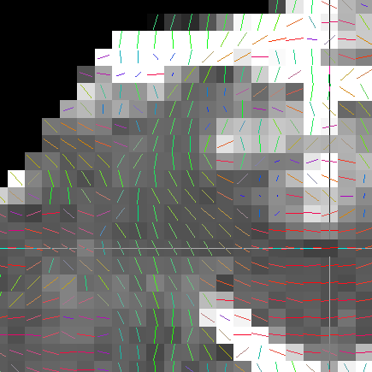
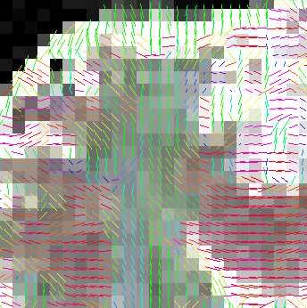
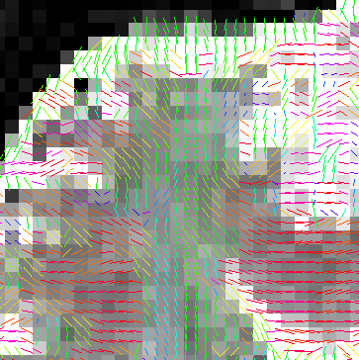
==== PhilipsAchieva2
NIIXFSL
DicomToNrrd
DicomToFSL
NIIXFSLToNrrd
DicomToFSLToNrrd
FSLVIEW
Slicer Display

Slide 17
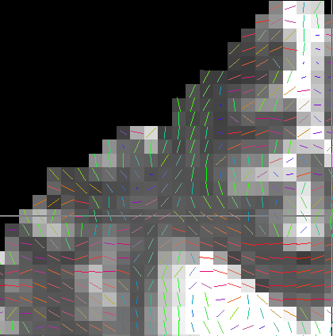
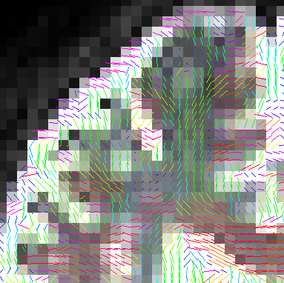
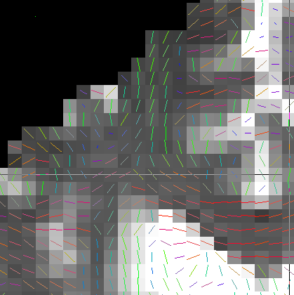
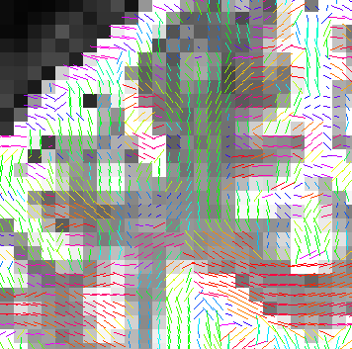

==== PhilipsAchieva3
NIIXFSL
DicomToNrrd
DicomToFSL
NIIXFSLToNrrd
DicomToFSLToNrrd
FSLVIEW
Slicer Display

Slide 18
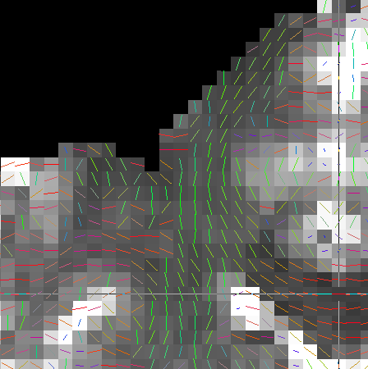
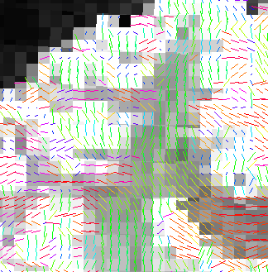
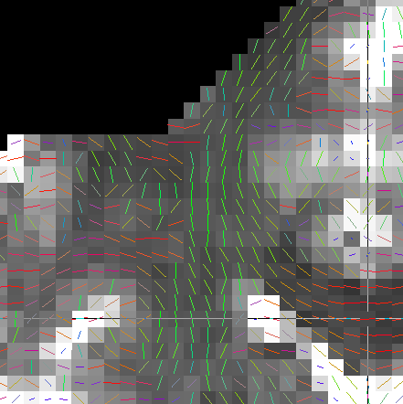
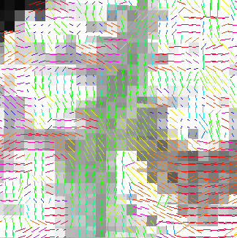
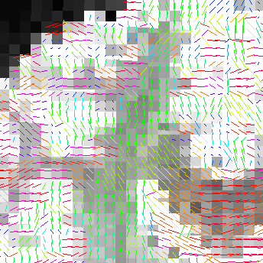
==== PhilipsAchieva4
NIIXFSL
DicomToNrrd
DicomToFSL
NIIXFSLToNrrd
DicomToFSLToNrrd
FSLVIEW
Slicer Display

Slide 19
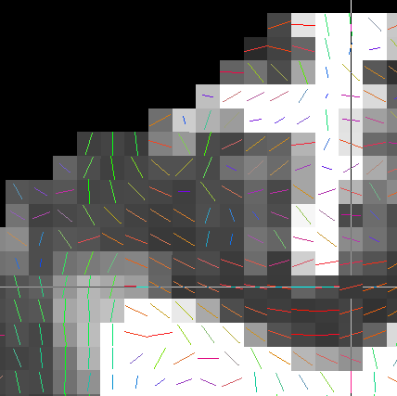
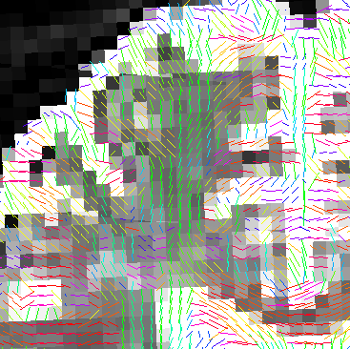
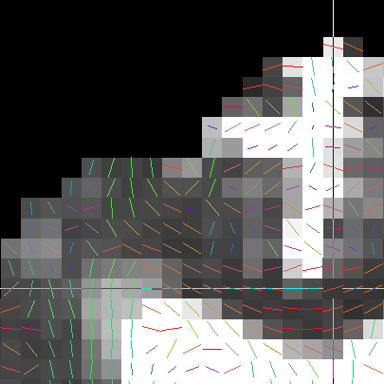
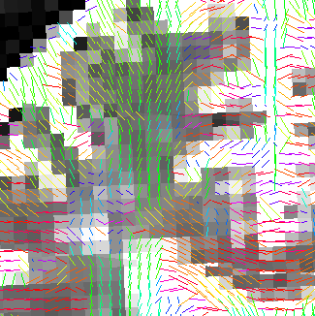
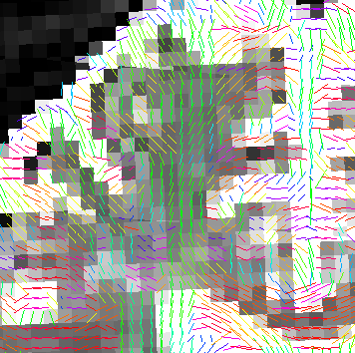
==== PhilipsAchieva6
NIIXFSL
DicomToNrrd
DicomToFSL
NIIXFSLToNrrd
DicomToFSLToNrrd
FSLVIEW
Slicer Display

Slide 20





==== PhilipsAchieva7
NIIXFSL
DicomToNrrd
DicomToFSL
NIIXFSLToNrrd
DicomToFSLToNrrd
FSLVIEW
Slicer Display

Slide 21





==== PhilipsAchievaBigEndian1
NIIXFSL
DicomToNrrd
DicomToFSL
NIIXFSLToNrrd
DicomToFSLToNrrd
FSLVIEW
Slicer Display

Slide 22





==== SiemensTrio-Syngo2004A-1
NIIXFSL
DicomToNrrd
DicomToFSL
NIIXFSLToNrrd
DicomToFSLToNrrd
FSLVIEW
Slicer Display

Slide 23





==== SiemensTrio-Syngo2004A-2
NIIXFSL
DicomToNrrd
DicomToFSL
NIIXFSLToNrrd
DicomToFSLToNrrd
FSLVIEW
Slicer Display

Slide 24





==== SiemensTrioTim1
NIIXFSL
DicomToNrrd
DicomToFSL
NIIXFSLToNrrd
DicomToFSLToNrrd
FSLVIEW
Slicer Display

Slide 25





==== SiemensTrioTim2
NIIXFSL
DicomToNrrd
DicomToFSL
NIIXFSLToNrrd
DicomToFSLToNrrd
FSLVIEW
Slicer Display

Slide 26





==== SiemensTrioTim3
NIIXFSL
DicomToNrrd
DicomToFSL
NIIXFSLToNrrd
DicomToFSLToNrrd
FSLVIEW
Slicer Display

Slide 27





==== SiemensTrioTimBigEndian1
NIIXFSL
DicomToNrrd
DicomToFSL
NIIXFSLToNrrd
DicomToFSLToNrrd
FSLVIEW
Slicer Display

Slide 28





==== SiemensVerio
NIIXFSL
DicomToNrrd
DicomToFSL
NIIXFSLToNrrd
DicomToFSLToNrrd
FSLVIEW
Slicer Display

